Slide 1



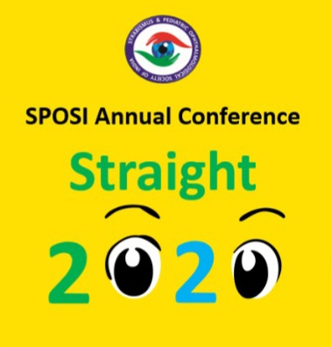
TITLE: IMPACT OF CATARACT SURGERY ON STEREOPSIS IN PEDIATRIC AGE GROUP.
There is no financial interest of any of the authors behind conducting this study and no financial assistance was provided by any institution or organization and there are no competing interests, conducted after approval of ethical committee
AUTHOR:
DR ASHWINI KORANNE
CO-AUTHORS:
DR MEHUL SHAH
DR SHREYA SHAH
DR MRUGESHA VAGHELA

Slide 2

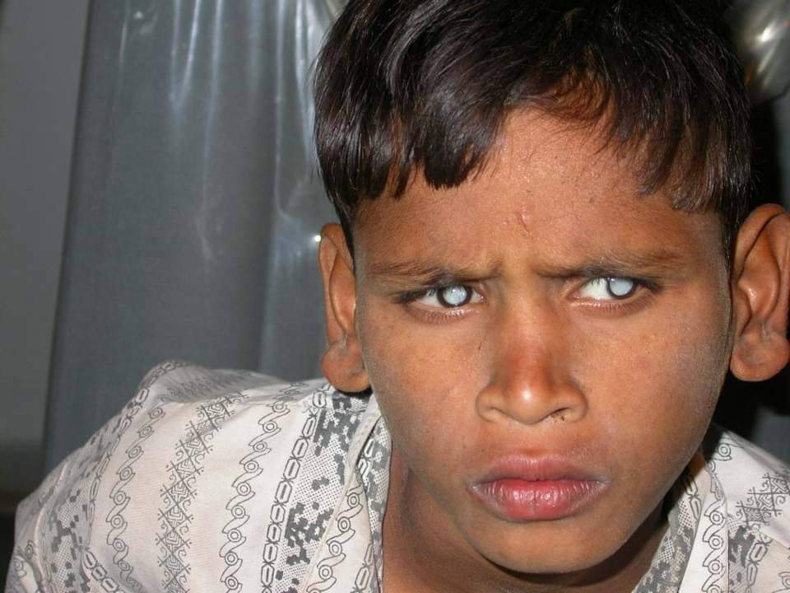
INTRODUCTION:
TO EVALUATE BINOCULAR FUNCTION FOLLOWING CATARACT SURGERIES IN CHILDREN

Slide 3

METHODS:
PROSPECTIVE STUDY AT TERTIARY CENTER.ALL EYES WITH CATARACT IN PEDIATRIC AGE GROUP UNDERWENT SURGERIES WITH PRIMARY POSTERIOR POLAR CATARACT.
ALL PATIENTS FOLLOWED UP FOR 1 YEAR AND TESTED FOR STEREOPSIS.
DATA DOCUMENTED IN PRETESTED FORMAT, DESCRIPTIVE AND CROSS TABULATION METHOD USED AND ANALYSED WITH SPSS 22.
P VALUE <0.05 CONSIDERED SIGNIFICANT

Slide 4
OBSERVATION TABLE:
SAMPLE SIZE | 20
MEAN AGE | 7.8+/_ 4 YEARS
FEMALE | 35 %
MALE | 65%
LATERALITY | U/L : 25% B/L: 75%
P VALUE | 0.008

Slide 5
RESULTS:
COHORT CONSISTED OF 20 PATIENTS IN PEDIATRIC AGE GROUP OPERATED FOR BILATARAL CATARACTS WITH MEAN AGE 7.8+/-4 YRS,35% FEMALE, 65% MALE,75% BILATERAL
ON COMPARISION OF PRE AND POST OPERATIVE VISION, A SIGNIFICANT DIFFERENCE (P=0.008) WAS FOUND.
WHEN COMPARISION WAS MADE ACCORDING TO VISUAL ACUITY AND LATERALITY, NO SIGNIFICANT DIFFERENCE IN STEREOPSIS WAS FOUND

Slide 6
CONCLUSION
IMPROVEMENT IN BINOCULAR FUNCTION IS NOT SYNCHRONOUS WITH VISION IMPROVEMENT IN PAEDIATRIC CATARACT SURGERIES.

Slide 7
THANK YOU

